Slide 1
EXODUS

Slide 2
EXODUS
¹ Moreover, brethren, I do not want you to be unaware that all our fathers were under the cloud, all passed through the sea, ² all were baptized into Moses in the cloud and in the sea, ³ all ate the same spiritual food, ⁴ and all drank the same spiritual drink. For they drank of that spiritual Rock
that followed them, and that Rock was Christ. ⁵ But with most of them God was not well pleased, for their bodies were scattered in the wilderness.
⁶ Now these things became our examples, to the intent that we should not lust after evil things as they also lusted.
1 Corinthians 10.1-6

Slide 3
EXODUS
LXX ~ ek + hodos – the way out
Hebrew ~ we`elleh semot – these are the names

Slide 4
EXODUS
Almost 400 years between Genesis 50.26 and Exodus 1.1
Types:
Egypt = type of the world
Amalekites= type of the flesh
Promised land= type of the Abundant Life

Slide 5
EXODUS
Have you come to the Red Sea place in your life
Where in spite of all you can do,
There is no way out.
There is no way back.
There is no other way but through?
Annie Johnston Flint

Slide 6
EXODUS
But concerning the dead, that they rise, have you not read in the book of Moses, in the burning bush passage, how God spoke to him, saying, "I am the God of Abraham, the God of Isaac, and the God of Jacob" ?
Mark 12.26

Slide 7
EXODUS
Hyksos (shepherd kings) 1684 – 1567 BC ~ Semitic

Slide 8
EXODUS
c. 1290 BC ~ Ramses I
c. 1445 BC ~ Amenhotep II
Pharaoh of the Exodus

Slide 9
EXODUS
²⁴ By faith Moses, when he became of age, refused to be called the son of Pharaoh’s daughter, ²⁵ choosing rather to suffer affliction with the people of God than to enjoy the passing pleasures of sin, ²⁶ esteeming the reproach of Christ greater riches than the treasures in Egypt; for he looked to the reward.
²⁷ By faith he forsook Egypt, not fearing the wrath of the king; for he endured as seeing Him who is invisible.
Hebrews 11.24-27

Slide 10
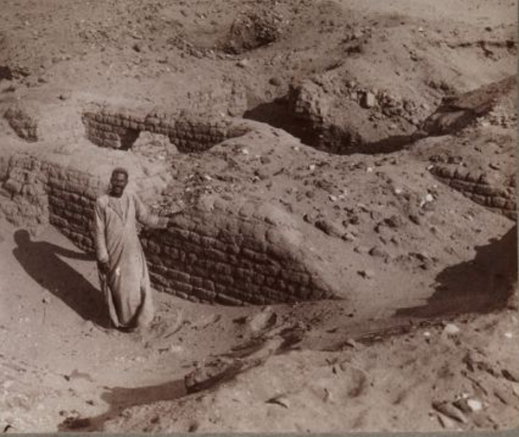
EXODUS
From 1904 postcard of Pithom, Egypt

Slide 11
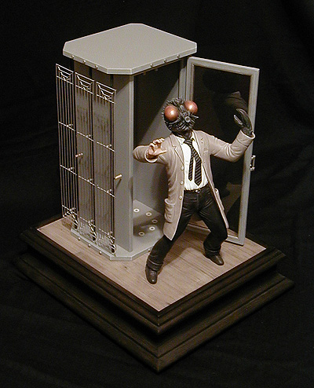
EXODUS
1. Blood ~ bloodstream of Osiris
2. Frogs ~ Heqt – goddess of birth
3. Lice ~ attack on the religious hygiene of the priests
4. Flies ~ Uatchit, the fly god
Ex. 18:19 ~ Then the magicians said to Pharaoh, "This is the finger of God."
5. Livestock ~ Apis, bull god; Hathor, cow goddess
Ten Plagues of Egypt

Slide 12
EXODUS
6. Boils ~ Imhotep; Thoth gods of medicine
7. Hail ~ Nut goddess of heavens and sky; Tefnut goddess of rain
8. Locusts ~ Senehem, protector against ravages and pests
9. Darkness ~ Ra, the sun god
10. Death of firstborn ~ whole Isis/Osirus worship
Ten Plagues of Egypt

Slide 13
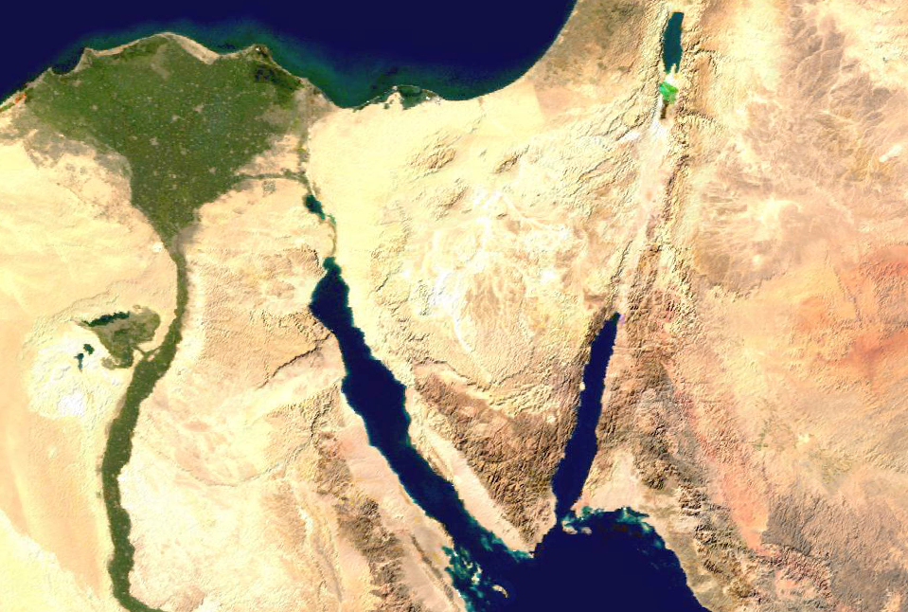
EXODUS
Traditional Mt. Sinai
Possible Mt. Sinai
From Goshen to Mt. Sinai

Slide 14
EXODUS
Behold, the virgin shall be with child, and bear a Son, and they shall call His name Immanuel, which is translated, "God with us."
And the Word became flesh and dwelt among us, and we beheld His glory, the glory as of the only begotten of the Father, full of grace and truth.
Dwelt ~ literally “tabernacled”
Matthew 1.23
John 1.14

